Slide 1
CPT-S 415
Big Data
Yinghui Wu
EME B45

Slide 2
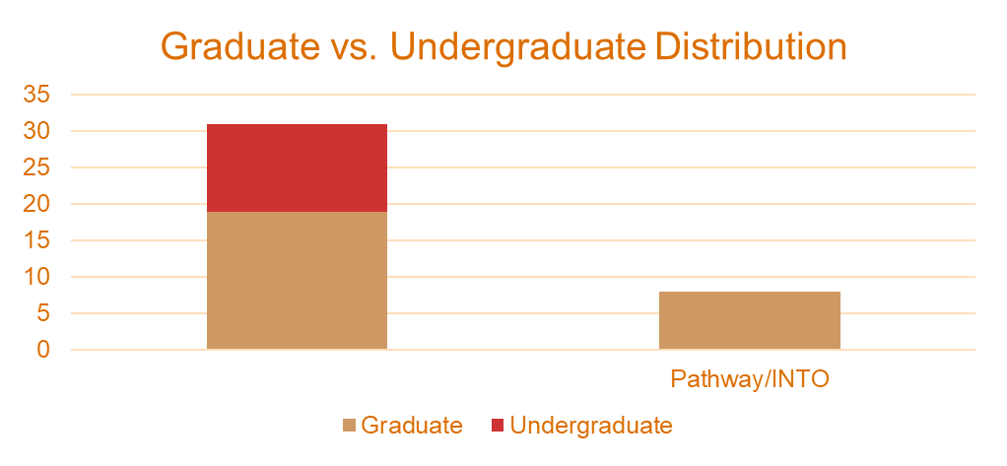
Initial Survey 2018 Fall
31 Returned Answers.
Participants: 19/31 Graduate (8 Pathway) 12/31Undergraduate
Computer Science, Business

Slide 3
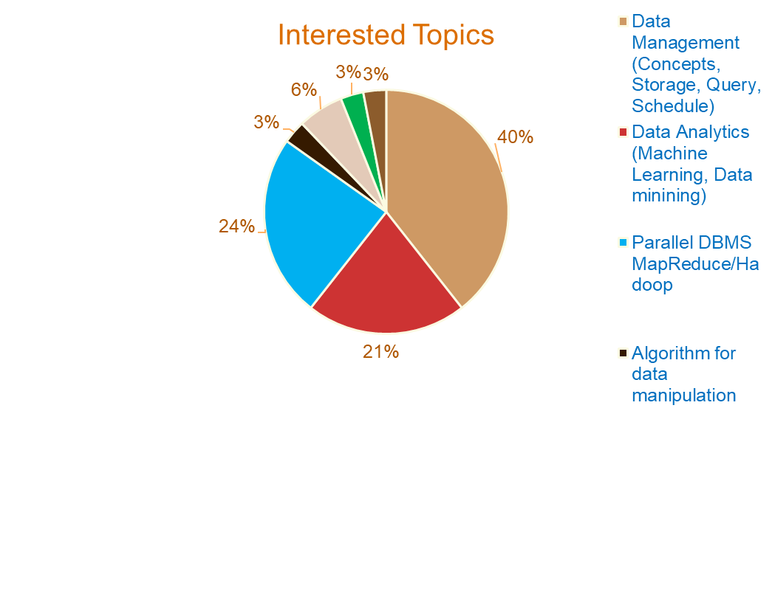
Interested Topics
Some Observations:
Interested topics:
Data Management (13/31)
Data Analytics ( 7/31)
Parallel DBMS (8/31)
Other:
Algorithm
Data quality
Data Stream and New SQL
Scalable data processing

Slide 4
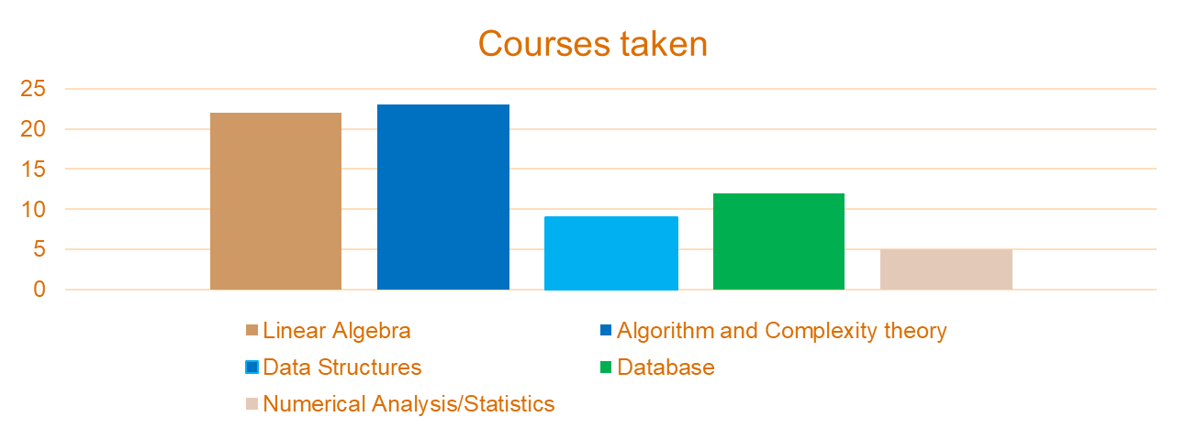
Courses Taken
  Courses Taken: Linear Algebra (22/31)
  Algorithm and Complexity Theory (23/31)
  Data Structures (9/31)
  Database (12/31)
  Numerical Analysis/Statistics (5/31)

Slide 5
Programming Language,
MapReduce and Cloud service experience
  MapReduce experience (4/31);
  Cloud service: Amazon EC2/EC3, Azure, Ali (9/31, some with Cloud storage user experience);
  Programming language:
  Python(21/31)
  C/C++(16/31)
  Java(16/31)
  C#(7/31)
  R(4/31)
  Other: Ruby, PHP, JS, Matlab

Slide 6
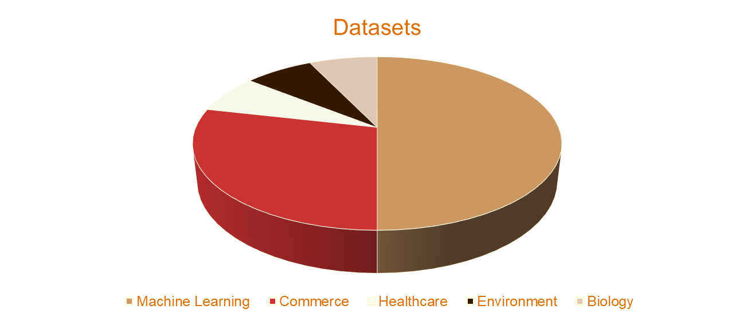
Data projects
Machine Learning | 7
Commerce | 4
Healthcare | 1
Environment | 1
Biology | 1

Slide 7
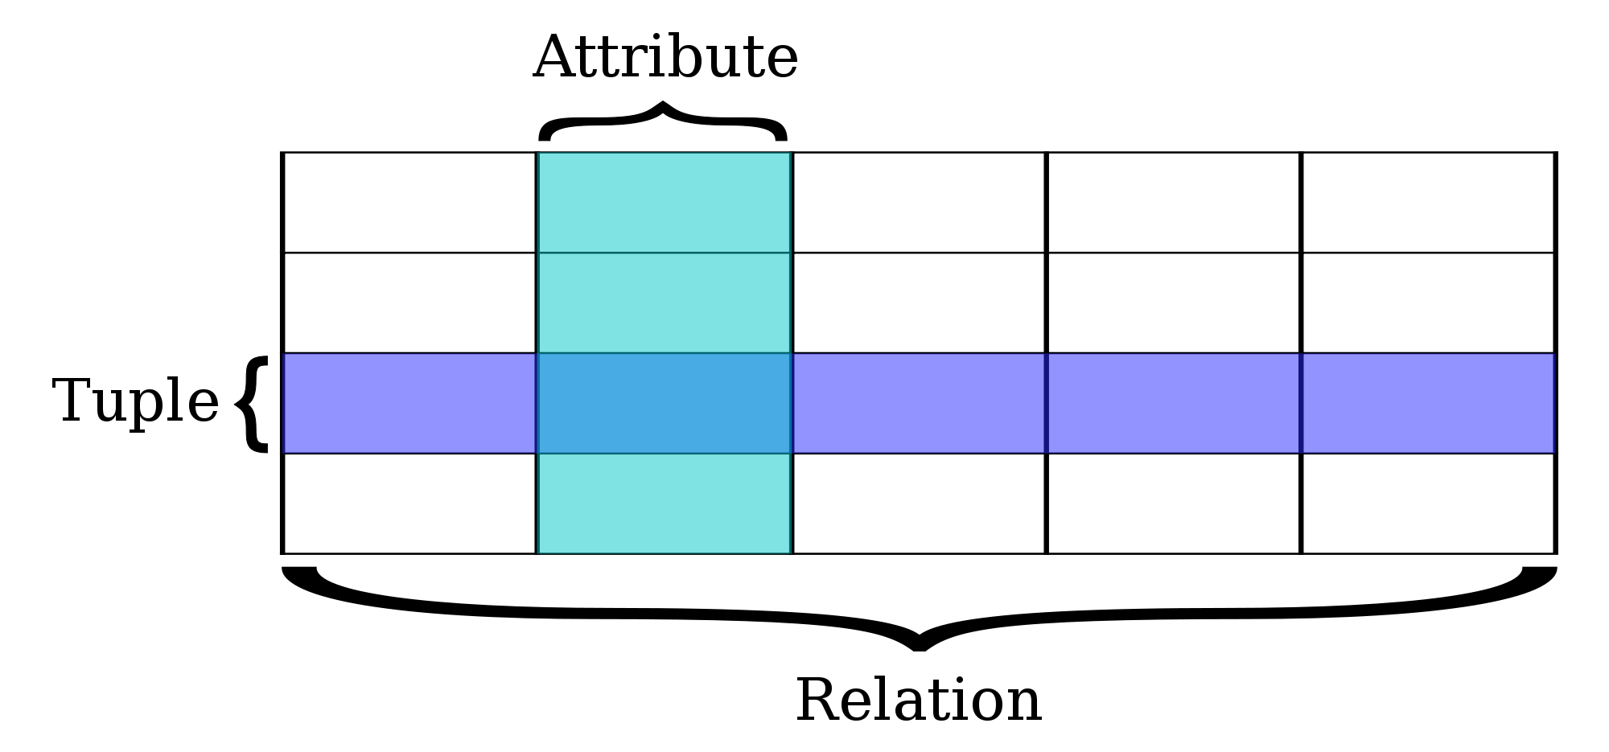
CPT-S 415
Big Data
Relational data model and DBMS
Relational Model Concepts
Constraints and Schemas
Update Operations and Constraint Violations
Notes:
Object.

Slide 8
Data Models
A collection of tools for describing
  Data relationships
  Data semantics
  Data constraints
Relational model
Entity-Relationship data model (mainly for database design)
Object-based data models (Object-oriented and Object-relational)
Semistructured data model (XML and graphs)
Other models:
  Network model
  Hierarchical model
  “What goes around comes around”, by Michael Stonebraker

Slide 9




Relational Model Concepts
A Relation is a mathematical concept based on the ideas of sets
The model was first proposed by Dr. E.F. Codd of IBM Research in 1970:
  "A Relational Model for Large Shared Data Banks," Communications of the ACM, June 1970
The above paper caused a major revolution in the field of database management and earned Dr. Codd the coveted ACM Turing Award
Turing Award winners who are data management researchers
  1973, Charles W.Bachman
  1981, Edgar.F. Codd
  1998, Jim Gray
  2014, Michael Stonebraker

Slide 10
Informal Definitions
Informally, a relation looks like a table of values.
A relation typically contains a set of rows.
The data elements in each row represent certain facts that correspond to a real-world entity or relationship
  In the formal model, rows are called tuples
Each column has a column header that gives an indication of the meaning of the data items in that column
  In the formal model, the column header is called an attribute name (or just attribute)

Slide 11
Informal Definitions
Key of a Relation:
  Each row has a value of a data item (or set of items) that uniquely identifies that row in the table
    Called the key
  In the STUDENT table, SSN is the key
  Sometimes row-ids or sequential numbers are assigned as keys to identify the rows in a table
    Called artificial key or surrogate key

Slide 12

Example of a Relation

Slide 13
Formal Definitions - Schema
The Schema (or description) of a Relation:
  Denoted by R(A1, A2, .....An)
  R is the name of the relation
  The attributes of the relation are A1, A2, ..., An
Example:
CUSTOMER (Cust-id, Cust-name, Address, Phone#)
  CUSTOMER is the relation name
  Defined over the four attributes: Cust-id, Cust-name, Address, Phone#
Each attribute has a domain or a set of valid values.
  For example, the domain of Cust-id is 6 digit numbers.

Slide 14
Formal Definitions - Domain
A domain has a logical definition:
  Example: “USA_phone_numbers” are the set of 10 digit phone numbers valid in the U.S.
A domain also has a data-type or a format.
  The USA_phone_numbers may have a format: (ddd)ddd-dddd where each d is a decimal digit.
  Dates have various formats such as year, month, date formatted as yyyy-mm-dd, or as dd mm,yyyy etc.
The attribute name designates the role played by a domain in a relation:
  Used to interpret the meaning of the data elements corresponding to that attribute
  Example: The domain Date may be used to define two attributes named “Invoice-date” and “Payment-date” with different meanings

Slide 15
Formal Definitions - Tuple
A tuple is an ordered n-tuple of values (enclosed in angled brackets ‘< … >’)
Each value is derived from an appropriate domain.
A row in the CUSTOMER relation is a 4-tuple and would consist of four values, for example:
  <632895, "John Smith", "101 Main St. Atlanta, GA 30332", "(404) 894-2000">
  This is called a 4-tuple as it has 4 values
  A tuple (row) in the CUSTOMER relation.
A relation is a set of such tuples (rows)

Slide 16
Formal Definitions - State
The relation state is a subset of the Cartesian product of the domains of its attributes
  each domain contains the set of all possible values the attribute can take.
Example: attribute Cust-name is defined over the domain of character strings of maximum length 25
  dom(Cust-name) is varchar(25)
The role these strings play in the CUSTOMER relation is that of the name of a customer.
What’s the difference between a state of a relation and
an instance of a relation?

Slide 17
Formal Definitions - Summary
Formally,
  Given R(A1, A2, .........., An)
  r(R) ⊂ dom (A1) X dom (A2) X ....X dom(An)
R(A1, A2, …, An) is the schema of the relation
R is the name of the relation
A1, A2, …, An are the attributes of the relation
r(R): a specific state (or "value" or “population”) of relation R – this is a set of tuples (rows)
  r(R) = {t1, t2, …, tn} where each ti is an n-tuple
  ti = <v1, v2, …, vn> where each vj element-of dom(Aj)

Slide 18
Formal Definitions - Example
Let R(A1, A2) be a relation schema:
  Let dom(A1) = {0,1}
  Let dom(A2) = {a,b,c}
Then: dom(A1) X dom(A2) is all possible combinations:
  {<0,a> , <0,b> , <0,c>, <1,a>, <1,b>, <1,c> }
The relation state r(R) ⊂ dom(A1) X dom(A2)
For example: r(R) could be {<0,a> , <0,b> , <1,c> }
  this is one possible state (or “population” or “extension”) r of the relation R, defined over A1 and A2.
  It has three 2-tuples: <0,a> , <0,b> , <1,c>

Slide 19
Definition Summary
Informal Terms |  | Formal Terms
Table |  | Relation
Column Header |  | Attribute
All possible Column Values |  | Domain
Row |  | Tuple
Table Definition |  | Schema of a Relation
Populated Table |  | State of the Relation

Slide 20
Example – A relation STUDENT

Slide 21
Characteristics Of Relations
Ordering of tuples in a relation r(R):
  The tuples are not considered to be ordered, even though they appear to be in the tabular form.
Ordering of attributes in a relation schema R (and of values within each tuple):
  We consider the attributes in R(A1, A2, ..., An) and the values in t=<v1, v2, ..., vn> to be ordered.

Slide 22

Same state as previous Figure (but with different order of tuples)

Slide 23
Characteristics Of Relations
Values in a tuple:
  All values are considered atomic (indivisible).
  Each value in a tuple must be from the domain of the attribute for that column
    If tuple t = <v1, v2, …, vn> is a tuple (row) in the relation state r of R(A1, A2, …, An)
    Then each vi must be a value from dom(Ai)
  component values of a tuple t : t[Ai] or t.Ai
  Similarly, t[Au, Av, ..., Aw] refers to the subtuple of t containing the values of attributes Au, Av, ..., Aw, respectively in t
  A special null value is used to represent values that are unknown or inapplicable to certain tuples.

Slide 24
Constraints
Notes:
1

Slide 25
Relational Integrity Constraints
Constraints are conditions that must hold on all valid relation states.
There are three main types of constraints in the relational model:
  Key constraints
  Entity integrity constraints
  Referential integrity constraints
Another implicit constraint: domain constraint
  Every value in a tuple must be from the domain of its attribute (or it could be null, if allowed for that attribute)

Slide 26
Key Constraints
Superkey of R:
  Is a set of attributes SK of R with the following condition:
    No two tuples in any valid relation state r(R) will have the same value for SK
    That is, for any distinct tuples t1 and t2 in r(R), t1[SK] ≠ t2[SK]
    This condition must hold in any valid state r(R)
Key of R:
  A "minimal" superkey
  That is, a key is a superkey K such that removal of any attribute from K results in a set of attributes that is not a superkey (does not possess the superkey uniqueness property)

Slide 27
Key Constraints (continued)
Example: Consider the CAR relation schema:
  CAR(State, Reg#, SerialNo, Make, Model, Year)
  CAR has two keys:
    Key1 = {State, Reg#}
    Key2 = {SerialNo}
  Both are also superkeys of CAR
  {SerialNo, Make} is a superkey but not a key.
In general:
  Any key is a superkey (but not vice versa)
  Any set of attributes that includes a key is a superkey
  A minimal superkey is a key

Slide 28
Key Constraints (continued)
If a relation has several candidate keys, one is chosen to be the primary key.
  The primary key attributes are underlined.
Example: Consider the CAR relation schema:
  CAR(State, Reg#, SerialNo, Make, Model, Year)
  We chose SerialNo as the primary key
The primary key value is used to uniquely identify each tuple in a relation
  Provides the tuple identity
Also used to reference the tuple from another tuple
  General rule: Choose as primary key the smallest of the candidate keys (in terms of size)
  Not always applicable – choice is sometimes subjective

Slide 29

CAR table with two candidate keys – LicenseNumber chosen as Primary Key

Slide 30

COMPANY Database Schema

Slide 31
Entity Integrity
Entity Integrity:
  The primary key attributes PK of each relation schema R in S cannot have null values in any tuple of r(R).
    This is because primary key values are used to identify the individual tuples.
    t[PK] ≠ null for any tuple t in r(R)
    If PK has several attributes, null is not allowed in any of these attributes
  Note: Other attributes of R may be constrained to disallow null values, even though they are not members of the primary key.

Slide 32
Referential Integrity
A constraint involving two relations
  The previous constraints involve a single relation.
Used to specify a relationship among tuples in two relations:
  The referencing relation and the referenced relation.
Tuples in the referencing relation R1 have attributes FK (called foreign key attributes) that reference the primary key attributes PK of the referenced relation R2.
  A tuple t1 in R1 is said to reference a tuple t2 in R2 if t1[FK] = t2[PK].
A referential integrity constraint can be displayed in a relational database schema as a directed arc from R1.FK to R2.

Slide 33
Referential Integrity (or foreign key)
Constraint
Statement of the constraint
  The value in the foreign key column (or columns) FK of the the referencing relation R1 can be either:
    (1) a value of an existing primary key value of a corresponding primary key PK in the referenced relation R2, or
    (2) a null.
In case (2), the FK in R1 should not be a part of its own primary key.

Slide 34
Displaying a relational database schema and its constraints
Each relation schema can be displayed as a row of attribute names
The name of the relation is written above the attribute names
The primary key attribute (or attributes) will be underlined
A foreign key (referential integrity) constraints is displayed as a directed arc (arrow) from the foreign key attributes to the referenced table
  Can also point the primary key of the referenced relation for clarity
Next slide shows the COMPANY relational schema diagram

Slide 35

Referential Integrity Constraints for COMPANY database

Slide 36
Other Types of Constraints
Semantic Integrity Constraints:
  based on application semantics and cannot be expressed by the model per se
  Example: “the max. no. of hours per employee for all projects he or she works on is 56 hrs per week”
A constraint specification language may have to be used to express these
SQL-99 allows triggers and ASSERTIONS to express for some of these

Slide 37
Populated database state
Each relation will have many tuples in its current relation state
The relational database state is a union of all the individual relation states
Whenever the database is changed, a new state arises
Basic operations for changing the database:
  INSERT a new tuple in a relation
  DELETE an existing tuple from a relation
  MODIFY an attribute of an existing tuple
Next slide shows an example state for the COMPANY database

Slide 38

Populated database state for COMPANY

Slide 39
Update Operations on Relations
INSERT a tuple.
DELETE a tuple.
MODIFY a tuple.
Integrity constraints should not be violated by the update operations.
Updates may propagate to cause other updates automatically. This may be necessary to maintain integrity constraints.

Slide 40
Update Operations on Relations
In case of integrity violation, several actions can be taken:
  Cancel the operation that causes the violation (RESTRICT or REJECT option)
  Perform the operation but inform the user of the violation
  Trigger additional updates so the violation is corrected (CASCADE option, SET NULL option)
  Execute a user-specified error-correction routine

Slide 41
Possible violations for each operation
INSERT may violate any of the constraints:
  Domain constraint:
    if one of the attribute values provided for the new tuple is not of the specified attribute domain
  Key constraint:
    if the value of a key attribute in the new tuple already exists in another tuple in the relation
  Referential integrity:
    if a foreign key value in the new tuple references a primary key value that does not exist in the referenced relation
  Entity integrity:
    if the primary key value is null in the new tuple

Slide 42
Possible violations for each operation
DELETE may violate only referential integrity:
  If the primary key value of the tuple being deleted is referenced from other tuples in the database
    Can be remedied by several actions: RESTRICT, CASCADE, SET NULL
    RESTRICT option: reject the deletion
      CASCADE option: delete all tuples that contain the foreign key value
      SET NULL option: set the foreign keys of the referencing tuples to NULL
  One of the above options must be specified during database design for each foreign key constraint

Slide 43
Possible violations for each operation
UPDATE may violate domain constraint and NOT NULL constraint on an attribute being modified
Any of the other constraints may also be violated, depending on the attribute being updated:
  Updating the primary key (PK):
    Similar to a DELETE followed by an INSERT
    Need to specify similar options to DELETE
  Updating a foreign key (FK):
    May violate referential integrity
  Updating an ordinary attribute (neither PK nor FK):
    Can only violate domain constraints

Slide 44
Summary
Relational Model Concepts
  Definitions
  Characteristics of relations
Discussed Relational Model Constraints and Relational Database Schemas
  Domain constraints’
  Key constraints
  Entity integrity
  Referential integrity
Described the Relational Update Operations and Dealing with Constraint Violations

Slide 45
In-Class Exercise
Consider the following relations for a database that keeps track of student enrollment in courses and the books adopted for each course:
STUDENT(SSN, Name, Major, Bdate)
COURSE(Course#, Cname, Dept)
ENROLL(SSN, Course#, Quarter, Grade)
BOOK_ADOPTION(Course#, Quarter, Book_ISBN)
TEXT(Book_ISBN, Book_Title, Publisher, Author)
Draw a relational schema diagram specifying the foreign keys for this schema.

